Slide 1
Support Vector Machines
Varol Kayhan, PhD

Slide 2
Support Vector Machines
Very popular
Powerful for both classification and regression
Can uncover both linear and nonlinear relationships!
Resource intensive!

Slide 3
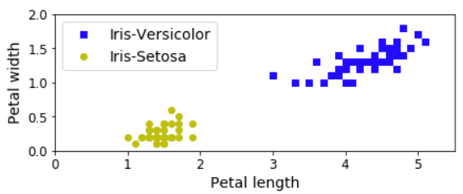
Linear SVM Classification
Iris data: separate one class from the other

Slide 4
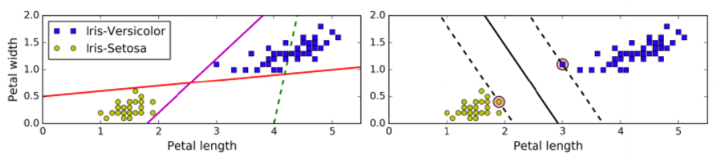
Linear SVM Classification
Iris data: separate one class from the other
Support vectors
Goal: fit the widest possible "street" between classes
Decision boundary (stays as far away as possible from instances)

Slide 5
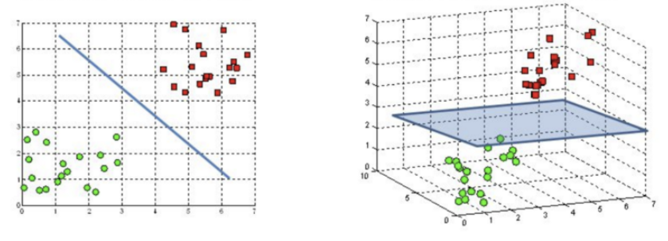
Linear SVM Classification
Hyperplanes: separate one class from another
In a 2-D world, the hyperplane is a "line"
In a 3-D world, the hyperplane is a "plane"
Image source: https://towardsdatascience.com/support-vector-machine-introduction-to-machine-learning-algorithms-934a444fca47

Slide 6
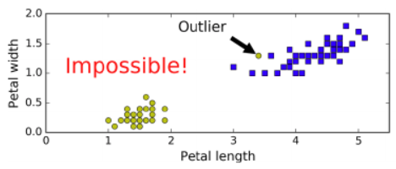


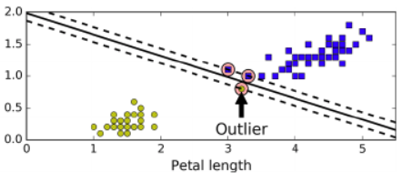

Hard Margin Classification
Data must be linearly separable
There must be NO outliers
(i.e., the perfect world!)

Slide 7
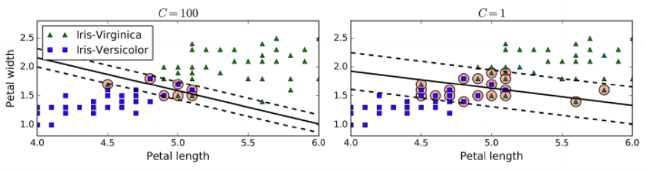
Soft Margin Classification
Allows margin violations
Instances that are "in the street" or "misclassified"
C is referred to as “regularization parameter”
Controls the width of the margin
Determines how much violation is allowed!
Higher C values perform LESS regularization
Leads to a SMALLER margin
Aims for less violations
There is a risk of overfitting
Lower C values perform MORE regularization
Leads to a WIDER margin
Aims for more violations
Favors generalizability

Slide 8
Nonlinear SVM Classification
Not all data are linearly separable
Solution 1:
Create polynomial features and fit a linear SVM!
Low polynomial degrees may fit the data well
Problem: High polynomial degrees generate too much data (so needs more resources!)
(Example on next slide)

Slide 9
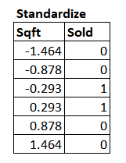
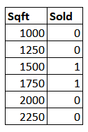

Nonlinear SVM Classification
Example

Slide 10
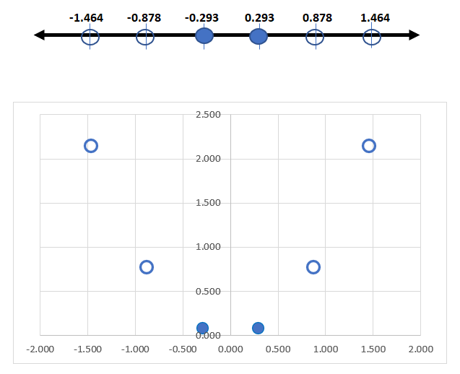
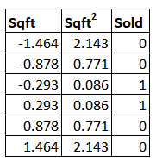
Nonlinear SVM Classification
Example

Slide 11
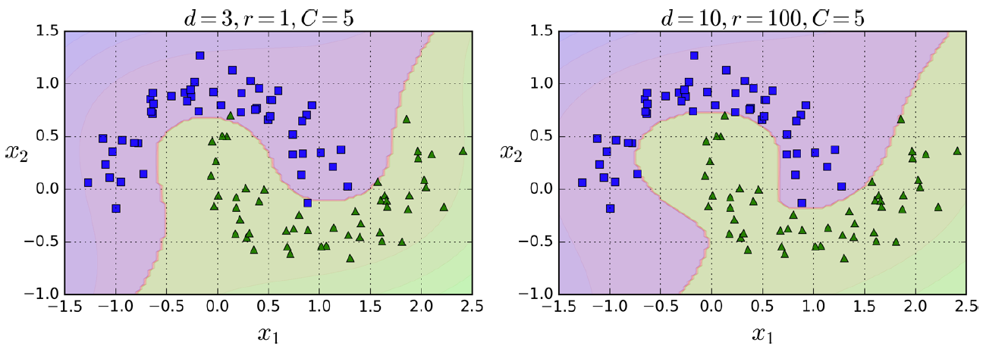
Nonlinear SVM Classification
Solution 2: use a "kernel trick"
Similar to adding many polynomial degrees (without actually adding them)
SVC(kernel="poly", degree=3, coef0=1, C=5)
coef0 controls how much the model should be influenced by higher degree polynomials
The number of features does not increase!!!
d=3, coef0=1, C=5
d=10, coef0=100, C=5

Slide 12


Adding Similarity Features
Another technique to tackle nonlinear classification
Adds "features" (i.e., new variables/dimensions) for separation of instances
Computationally expensive
x3
x2
x1

Slide 13
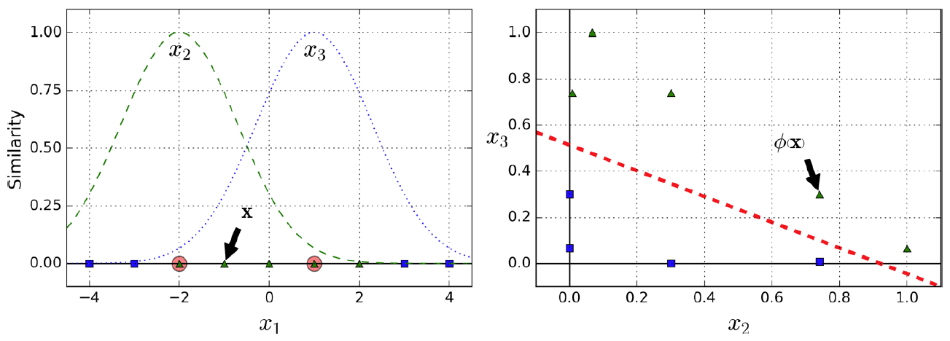
Gaussian RBF Kernel
The kernel trick to add similarity features
Gaussian Radial Basis Function
Landmarks

Slide 14
Gaussian RBF Kernel
SVC(kernel="rbf", gamma=5, C=0.001)
Higher gamma makes the bell shape narrower
Smaller gamma makes the bell shape wider
Increase gamma if the model is underfitting!
Decrease gamma if overfitting!

Slide 15
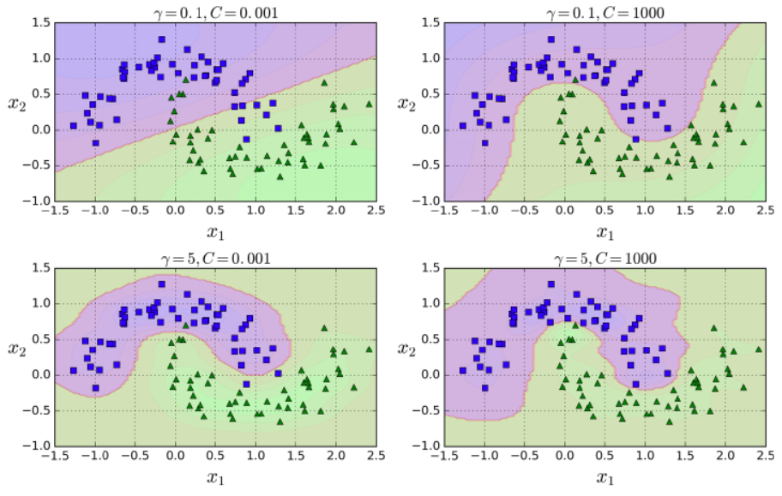
Gaussian RBF Kernel
Increase C to minimize violations
Increase gamma to address underfitting

Slide 16
Computational Complexity
LinearSVC is nearly identical to SVC(kernel=”linear”)
LinearSVC:
More efficient than SVC(kernel=“linear”)
Doesn't support kernel tricks
SVC(kernel=“linear”)
Supports kernel tricks (such as “poly” and “rbf”)
Takes time to train for large data sets

Slide 17
Multi-Class Classification
SVM cannot perform multi-class classification (in its true sense)
Instead, it performs: one-versus-rest ("ovr")
Create multiple binary class classification models
Run the observation on these models
Make a final determination based on the combined results

Slide 18
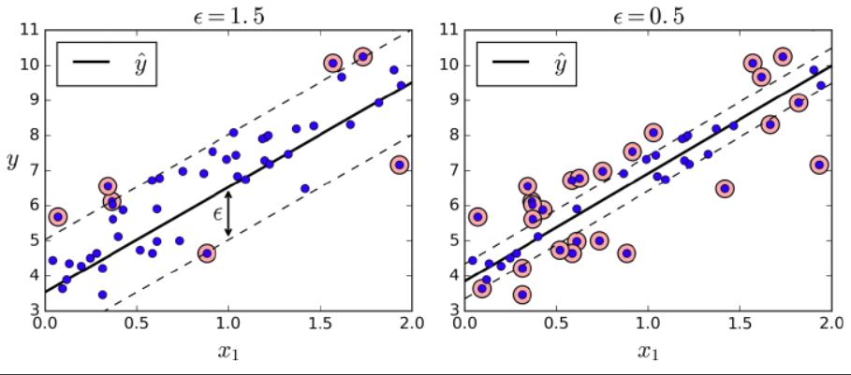
SVM Regression
SVM can be used to predict numerical values too
Instead of creating the widest street, fits most instances on the street
The width of the street is controlled by epsilon

Slide 19
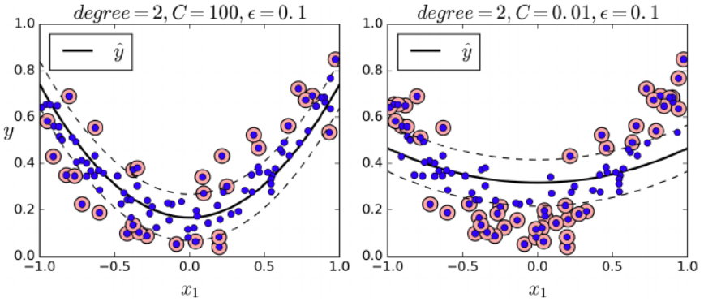
SVM Regression
Use kernelized SVM for polynomial models

Slide 20
Python Cheatsheet
C: regularization
Small C: wide margin, allows more violations (i.e., generalizable)
High C: small margin, allows less violations (i.e., overfitting)
coef0: used for poly kernel
Controls how much the model is influenced by higher degree polynomials
gamma: the shape of the bell for Gaussian RBF
Higher values make it narrower
Smaller values make it wider
tol: precision parameter
epsilon: width of the margin in regression

